Slide 1
24
Option Valuation

Slide 2

Chapter 24 – Index of Sample Problems
Slide # 02 - 03 Protective put strategy
Slide # 04 - 05 Risk-free asset plus call
Slide # 06 - 09 Put-call parity
Slide # 10 - 13 Continuous compounding
Slide # 14 - 15 Continuously compounded r_{f} rate
Slide # 16 - 21 Black-Scholes Option Pricing Model
Slide # 22 - 24 Delta – Call and put option
Slide # 25 - 32 Firm equity and debt valuation

Slide 3
2: Protective put strategy
You buy one share of GEM stock for $68. You also buy one put option on GEM stock with a $60 strike price. The cost of the put is $1. The put expires in one year.
What is your profit if the stock price is $80 one year from now?
What is the most you can lose over the next year?

Slide 4
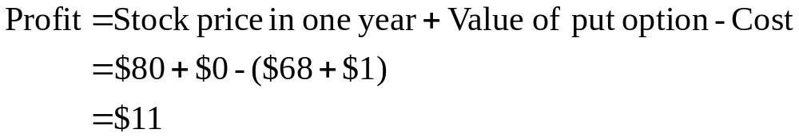
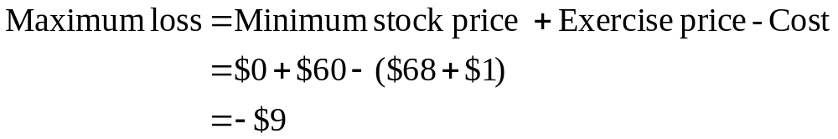
3: Protective put strategy
You buy one share of GEM stock for $68. You also buy one put option on GEM stock with a $60 strike price. The cost of the put is $1. The put expires in one year.
What is your profit if the stock price is $80 one year from now?
What is the most you can lose over the next year?

Slide 5
4: Risk-free asset plus call
You spend $11.86 to buy a one year call option on GEM stock with a strike price of $60. You also invest $57.14 in a one year risk-free asset which pays 5% interest.
How much profit will you earn if the stock is worth $80 one year from now?
What is the most you can lose over the next year?

Slide 6
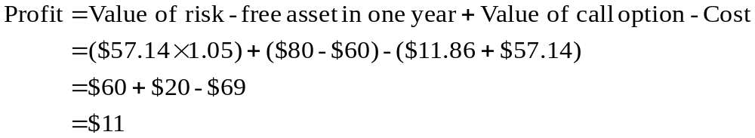
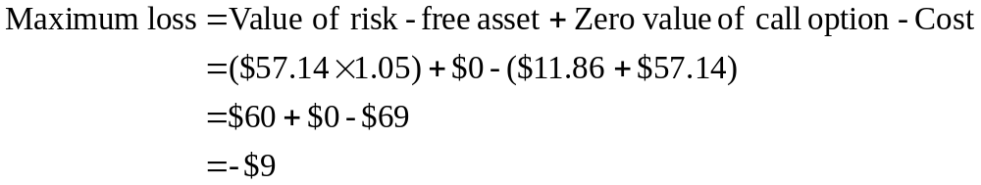
5: Risk-free asset plus call
You spend $11.86 to buy a one year call option on GEM stock with a strike price of $60. You also invest $57.14 in a one year risk-free asset which pays 5% interest.
How much profit will you earn if the stock is worth $80 one year from now?
What is the most you can lose over the next year?

Slide 7
6: Put – call parity
The current market price of HO stock is $40. A 3 month call on HO stock with a strike price of $45 is priced at $1. The risk-free rate of return is 0.3 percent per month.
What is the price of a 3 month put on HO stock with a strike price of $45?

Slide 8
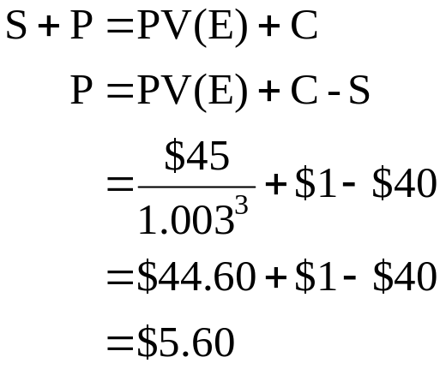
7: Put – call parity
The current market price of HO stock is $40. A 3 month call on HO stock with a strike price of $45 is priced at $1. The risk-free rate of return is 0.3 percent per month.
What is the price of a 3 month put on HO stock with a strike price of $45?

Slide 9
8: Put – call parity
GO, Inc. stock is currently selling for $35 a share. The one year call on GO stock with a strike price of $35 is priced at $3. The one year put on GO stock with a strike price of $35 is priced at $1.
What is the risk-free rate of return?

Slide 10
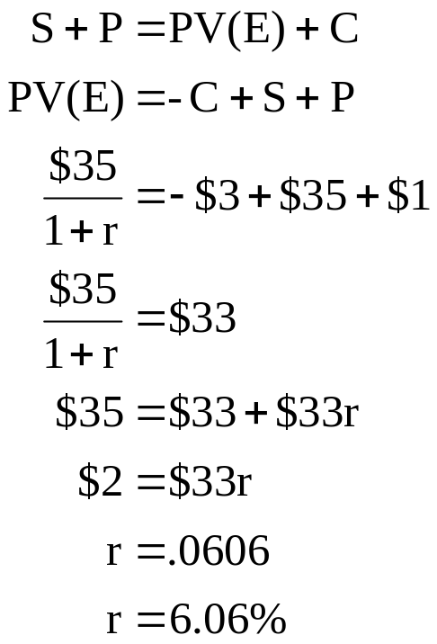
9: Put – call parity
GO, Inc. stock is currently selling for $35 a share. The one year call on GO stock with a strike price of $35 is priced at $3. The one year put on GO stock with a strike price of $35 is priced at $1.
What is the risk-free rate of return?

Slide 11
10: Continuous compounding
You invest $1,500 today at a rate of 7%, compounded continuously.
What will the value of your investment be three years from now ?

Slide 12
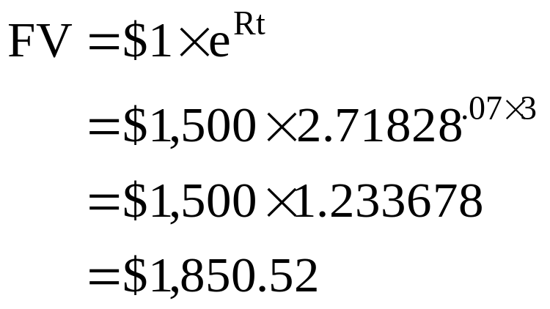
11: Continuous compounding
You invest $1,500 today at a rate of 7%, compounded continuously.
What will the value of your investment be three years from now ?

Slide 13
12: Continuous compounding
You can invest money today at a rate of 8%, compounded continuously. You want to have $20,000 in this account ten years from now.
How much do you have to invest today to achieve your goal if this is the only deposit you will make to this account?

Slide 14
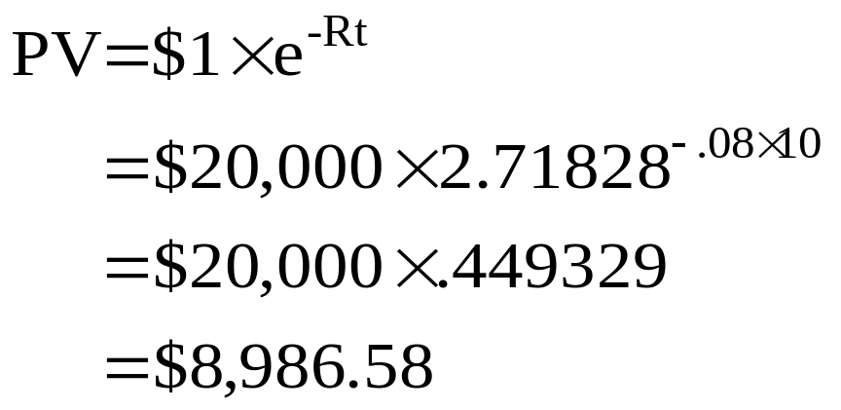
13: Continuous compounding
You can invest money today at a rate of 8%, compounded continuously. You want to have $20,000 in this account ten years from now.
How much do you have to invest today to achieve your goal if this is the only deposit you will make to this account?

Slide 15
14: Continuously compounded r_{f} rate
Zoe, Inc. stock is selling for $40 a share. A six month call option on Zoe stock with a $35 strike price is selling for $8. A six month put option on Zoe stock with a $35 strike price is selling for $2.
What is the continuously compounded risk-free rate?

Slide 16

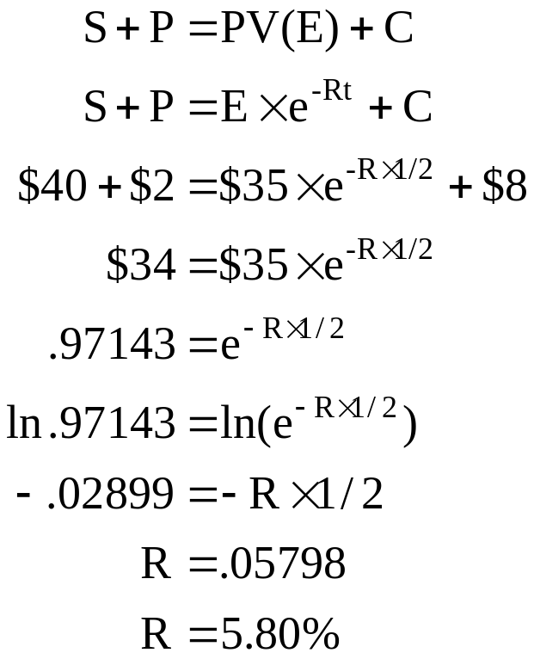
15: Continuously compounded r_{f} rate
Zoe, Inc. stock is selling for $40 a share. A six month call option on Zoe stock with a $35 strike price is selling for $8. A six month put option on Zoe stock with a $35 strike price is selling for $2.
What is the continuously compounded risk-free rate?

Slide 17
16: Black-Scholes Option Pricing Model
Given the following information, what is the price of a European call option? You will need to use either the cumulative normal distribution table found in chapter 24, section 2 of your textbook or an option pricing spreadsheet.
Stock price $50
Exercise price $45
Time to expiration 3 months
Risk-free rate 4% per year, compounded continuously
Standard deviation 20%

Slide 18
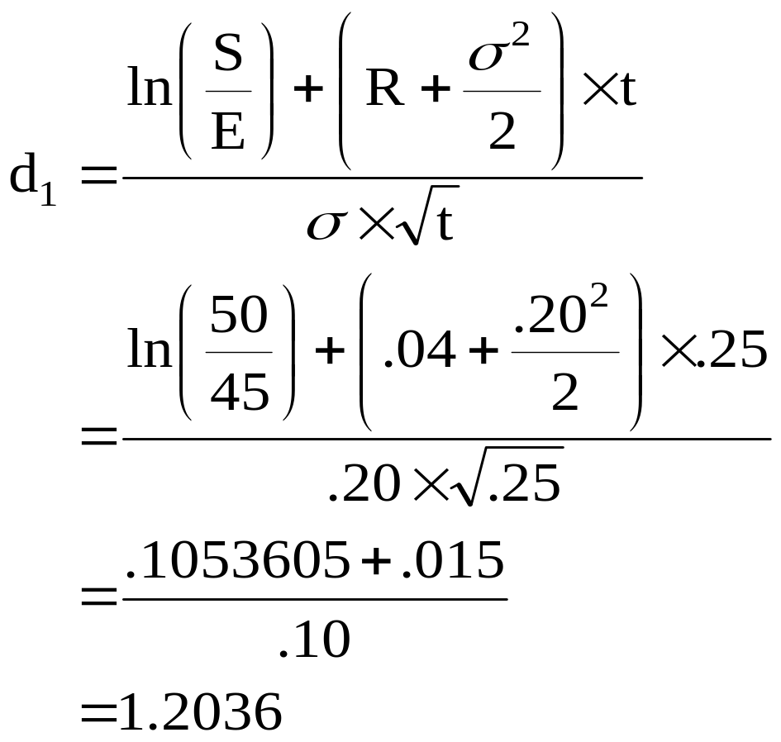
17: Black-Scholes Option Pricing Model
Stock price $50
Exercise price $45
Time to expiration .25
Risk-free rate 4%
Standard deviation 20%

Slide 19
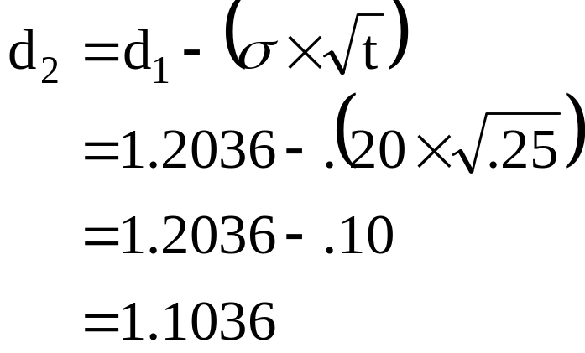
18: Black-Scholes Option Pricing Model
Stock price $50
Exercise price $45
Time to expiration .25
Risk-free rate 4%
Standard deviation 20%
d₁ 1.2036

Slide 20
19: Black-Scholes Option Pricing Model
Stock price $50
Exercise price $45
Time to expiration .25
Risk-free rate 4%
Standard deviation 20%
d₁ 1.2036
d₂ 1.1036
N(d1) = .8856
N(d2) = .8651
The N values can be computed either by using a spreadsheet or by
interpolation using the cumulative normal distribution table in the
textbook.

Slide 21
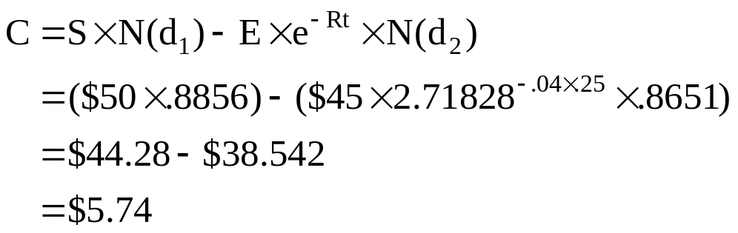
20: Black-Scholes Option Pricing Model
Stock price $50
Exercise price $45
Time to expiration .25
Risk-free rate 4%
Standard deviation 20%
d₁ 1.2036
d₂ 1.1036
N(d₁) .8856
N(d₂) .8651

Slide 22
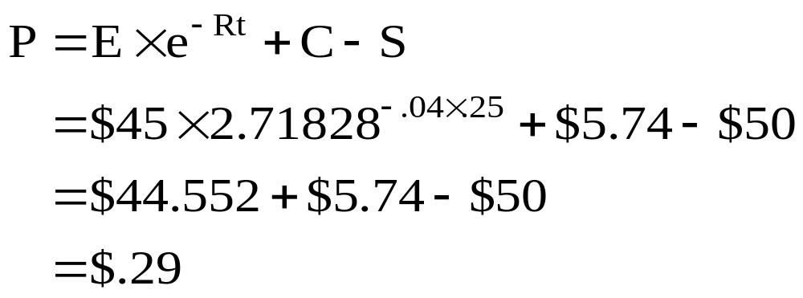
21: Black-Scholes Option Pricing Model
Stock price $50
Exercise price $45
Time to expiration .25
Risk-free rate 4%
Standard deviation 20%
d₁ 1.20
d₂ 1.10
N(d₁) .8856
N(d₂) .8651
C $5.74

Slide 23
22: Delta – Call and put option
You are given the following information on a stock:
Stock price $28
Exercise price $25
Time to expiration 6 months
Risk-free rate 4%
Standard deviation 30%
What is the delta for a call option?
What is the delta for a put option?

Slide 24
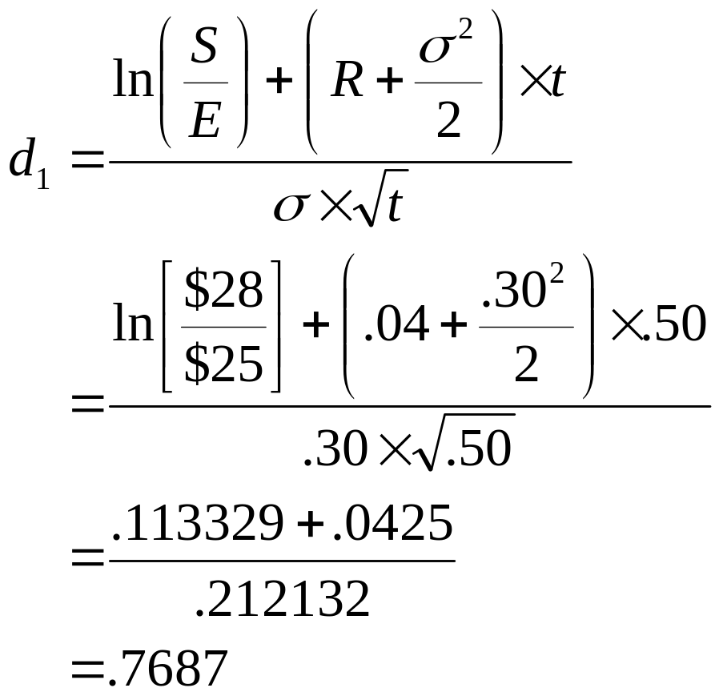

23: Delta – Call and put option
Stock price $28
Exercise price $25
Time to expiration .5
Risk-free rate 4%
Standard deviation 30%
What is the delta for a call option?

Slide 25
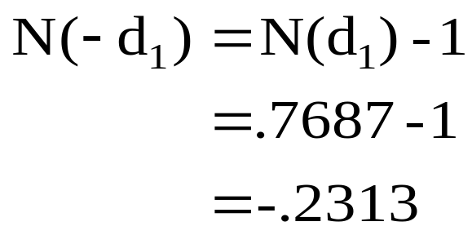
24: Delta – Call and put option
Stock price $28
Exercise price $25
Time to expiration .5
Risk-free rate 4%
Standard deviation 30%
N(d₁) .7346
What is the delta for a put option?

Slide 26
25: Firm equity and debt valuation
The Addept Co. has zero coupon bonds outstanding with a total face value of $120 million. These bonds mature in three years. The current market value of the firm’s assets is $140 million, with a standard deviation of 20% per year. The risk-free rate is 5% per year compounded continuously.
What is the market value of the firm’s equity?

Slide 27
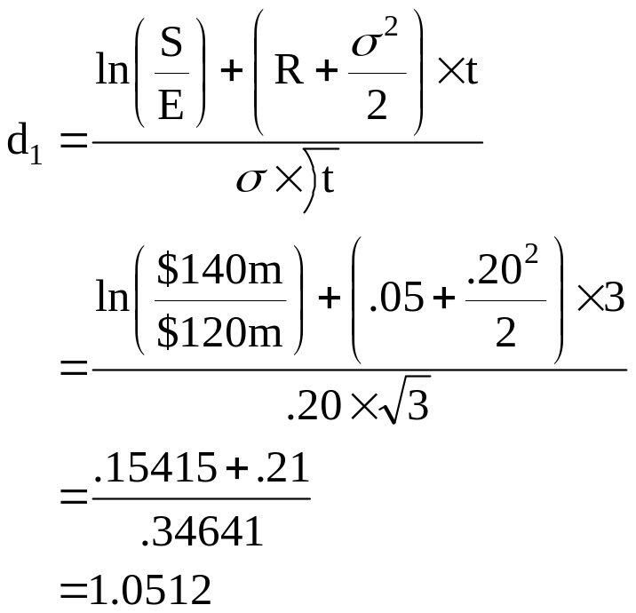
26: Firm equity and debt valuation
The Addept Co. has zero coupon bonds outstanding with a total face value of $120 million. These bonds mature in three years. The current market value of the firm’s assets is $140 million, with a standard deviation of 20% per year. The risk-free rate is 5% per year compounded continuously. What is the market value of the firm’s equity?
S $140m
E $120m
T 3
R .05
.20
Step 1:

Slide 28
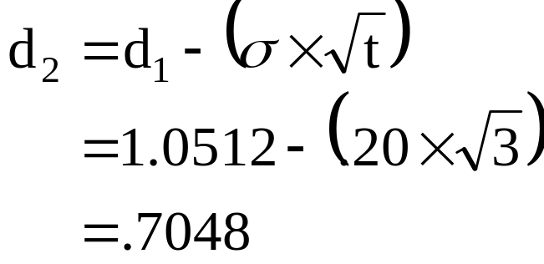
27: Firm equity and debt valuation
Step 2:
The Addept Co. has zero coupon bonds outstanding with a total face value of $120 million. These bonds mature in three years. The current market value of the firm’s assets is $140 million, with a standard deviation of 20% per year. The risk-free rate is 5% per year compounded continuously. What is the market value of the firm’s equity?
S $140m d₁ = 1.0512
E $120m
T 3
R .05
σ .20
Step 3:
N(d1) =.8534
N(d2) = .7595

Slide 29
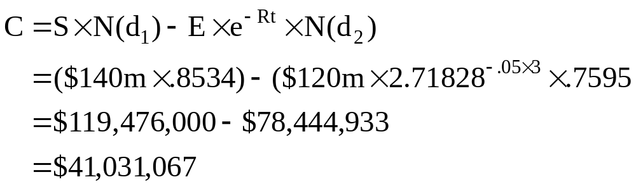
28: Firm equity and debt valuation
The Addept Co. has zero coupon bonds outstanding with a total face value of $120 million. These bonds mature in three years. The current market value of the firm’s assets is $140 million, with a standard deviation of 20% per year. The risk-free rate is 5% per year compounded continuously. What is the market value of the firm’s equity?
S $140m
E $120m
T 3
R .05
σ .20
d₁ = 1.0512
d₂ = .7048
N(d₁) = .8534
N(d₂) = .7595

Slide 30
29: Firm equity and debt valuation
The current market value of the assets of the Addept Co. is $140 million. The market value of the firm’s equity is $41,031,067.
What is the market value of the debt?

Slide 31
30: Firm equity and debt valuation
The current market value of the assets of the Addept Co. is $140 million. The market value of the firm’s equity is $41,031,067. What is the market value of the debt?

Slide 32
31: Firm equity and debt valuation
The current market value of the assets of the Addept Co. is $140 million. The market value of the firm’s debt is $98,968,933. The company has zero coupon bonds outstanding with a total face value of $120 million that mature in three years.
What is the firm’s continuously-compounded cost of debt?

Slide 33
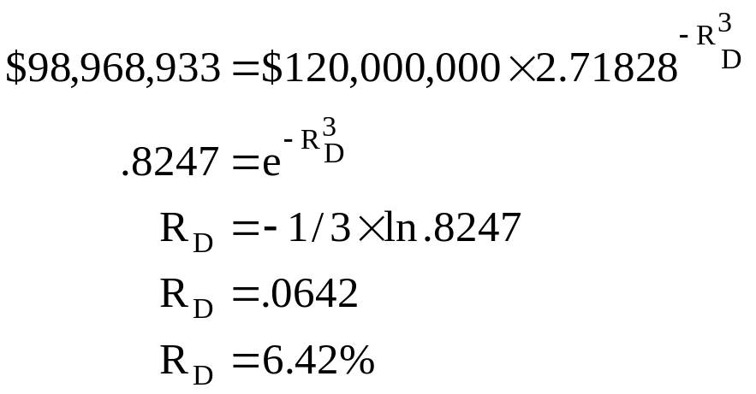
32: Firm equity and debt valuation
The current market value of the assets of the Addept Co. is $140 million. The market value of the firm’s debt is $41,031,067.
The company has zero coupon bonds outstanding with a total face value of $120 million.
What is the firm’s continuously-compounded cost of debt?

Slide 34
24
End of Chapter 24

